Slide 2
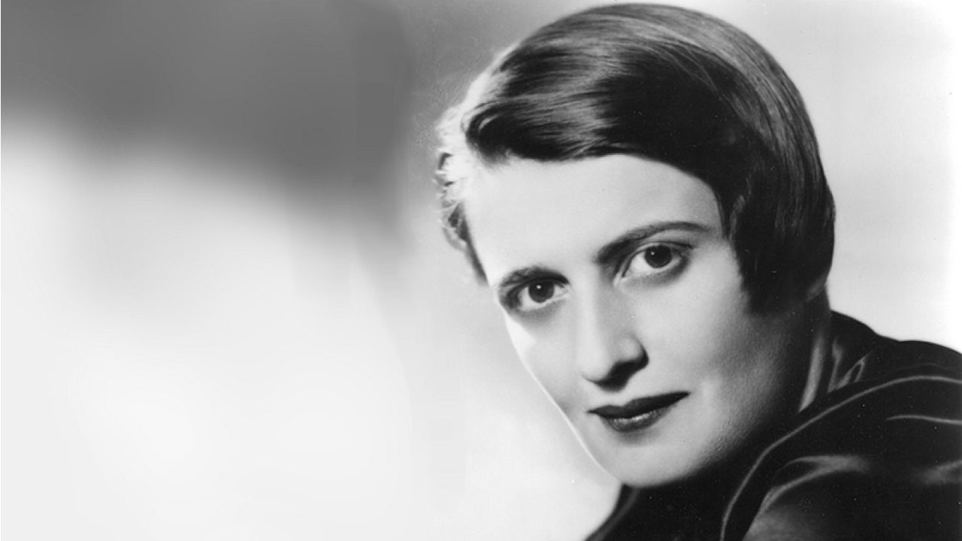
Ayn Rand

Slide 3
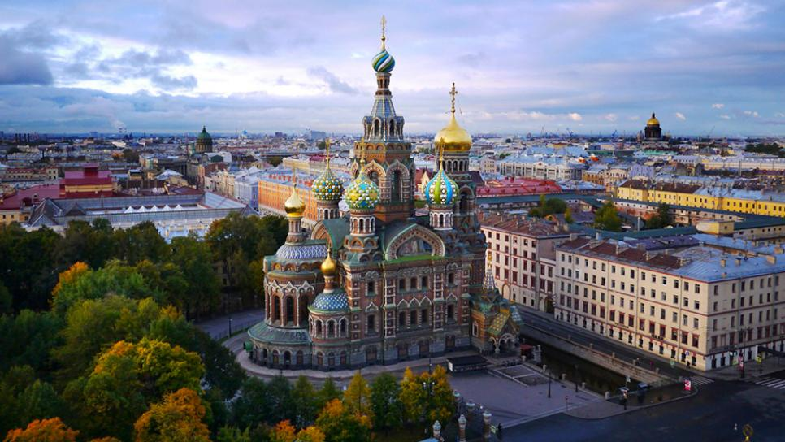
Early Life
Ayn Rand was born in St. Petersburg, Russia, in 1905
She was born to an upper-middle class family
Her father owned a pharmacy
Rand was a bright child and taught herself to read
By the age of 9, she had decided she would become a writer

Slide 4
The Russian Revolution of 1917 and The Bolshevik Revolution
Prior to the revolutions of 1917, Russia was a monarchy with Czar (Tsar) Nicolas II as its leader.
Russia’s economy was in crisis, people were starving, massive casualties had been suffered during WWI and the government was corrupt.
In March of 1917, angry and hungry Russians took to the streets of St. Petersburg.

Slide 5
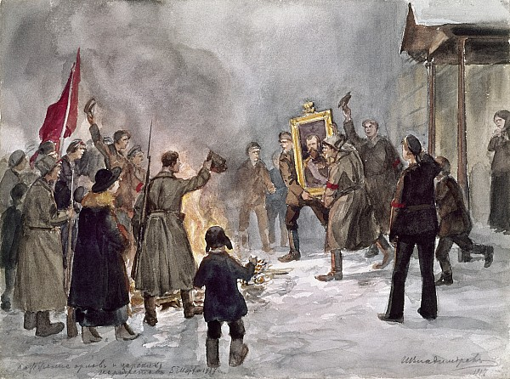
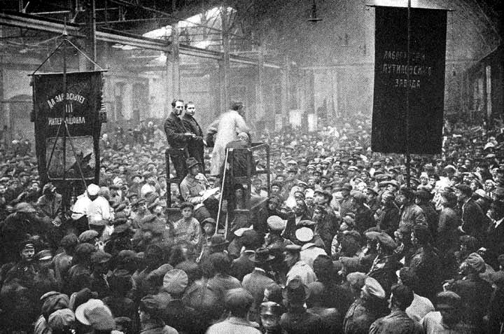
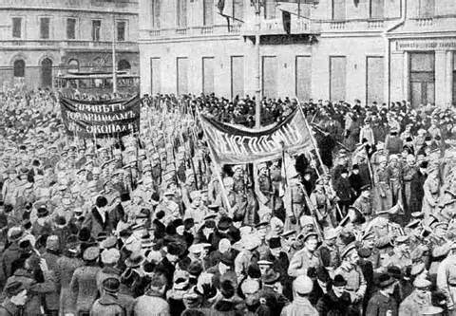

Slide 6
The Russian Revolution of 1917 and The Bolshevik Revolution
Soon after the February Revolution, the Bolshevik Revolution took place
The Bolsheviks, led by Lenin, were a small group whose philosophy was based on Karl Marx’s Communist Manifesto
After realizing that they did not have enough support to be able to rule without sharing power in a parliamentary government, the Bolsheviks declared themselves a dictatorship.
As a result of the revolutions, Rand’s father lost his pharmacy and the family faced near starvation.

Slide 7
Immigration to The United States
Rand learned about the United States during her final year of high school and fell in love with its democratic ideologies and capitalist society.
In 1925, Rand asked for permission to visit relatives in the United States and never returned to the Soviet Union.
She would eventually become employed in Hollywood and would work on films, as well as on novels and developing her philosophy of Objectivism.

Slide 8
Impacts of Life on Art
The Soviet Union was a Communist country
According to the Merriam-Webster Dictionary, communism is a government system in which goods are owned in common and are available to all as needed
Rand opposed communism heavily. She believed in the rights of the individual, and despised the collectivist society of Russia.

Slide 9
Four Major Themes in Anthem
We will disuss four major themes as we read Anthem:
Collectivism
Individualism
Conformity
Equality

Slide 10
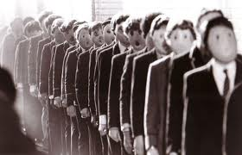
Collectivism
Collectivism refers to an emphasis on collective rather than individual action or identity.

Slide 11
Individualism
Individualism is the opposite of collectivism. Individualism focuses on individual action and identity.

Slide 12
Conformity
The theme of conformity is closely related to the theme of individuality. To conform means to be similar or identical, or to be obedient or compliant. School uniforms can be an example of conformity:

Slide 13
Equality
Equality is the final theme within Anthem that we will discuss. Equality occurs when things are like (the same) in status, quality, nature, etc.

Slide 14
Your Thoughts:
Can equality ever truly exist?
Why or why not?

